Slide 1
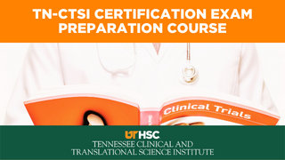
Notes:
Good morning everyone. Derita and I want to welcome you to today’s session for our TN-CTSI Certification Exam Preparation Course. Please keep your mic muted unless you are answering a question. And keep your video off to prevent internet problems. You will receive a certificate of attendance for this and every class you attend. If you are calling in and need a certificate please email me at mlynn@uthsc.edu.

Slide 2
Session 18:
Contracts
Study Closure
Differences Between FDA OHRP and ICH
Notes:
In today’s session we will discuss three different topics: Contracts, Study Closure and the Differences between FDA, OHRP and ICH. This will be a short session.

Slide 3
Need information?
Worksheets
Contracts and Agreements
Handouts / Reference Sheets
Significant Differences Among OHRP, FDA, and ICH GCP
NIDCR Study Close-out Checklist
Webinars to view
Research 103, Session Two
dbran@uthsc.edu
mlynn@uthsc.edu
Tennessee Clinical and Translational Science Institute
Seminars and Workshops – TN-CTSI (uthsc.edu)
Derita Bran and Margaret Lynn have no financial or other conflict of interest disclosures.
Notes:
Here are the worksheets that you need to complete for this session. I hope you are have worked ahead because the lectures will be more meaningful if you do. And I want to emphasize again that you will not be able to pass the certification exam by only listening to the sessions. You will need to use the study guide at the TN-CTSI website. The guide is lengthy, very lengthy, but is gives you the resources, worksheets, and an opportunity to view previous videos on the subjects that we cover in this series. However, the sessions focus more on regulatory information that you will need to pass your test. So that being said, let’s move forward.
Just a reminder, we will have an additional class on March 22 to make-up for the Feb 3rd ice-storm power outage and that will be our last session.

Slide 4
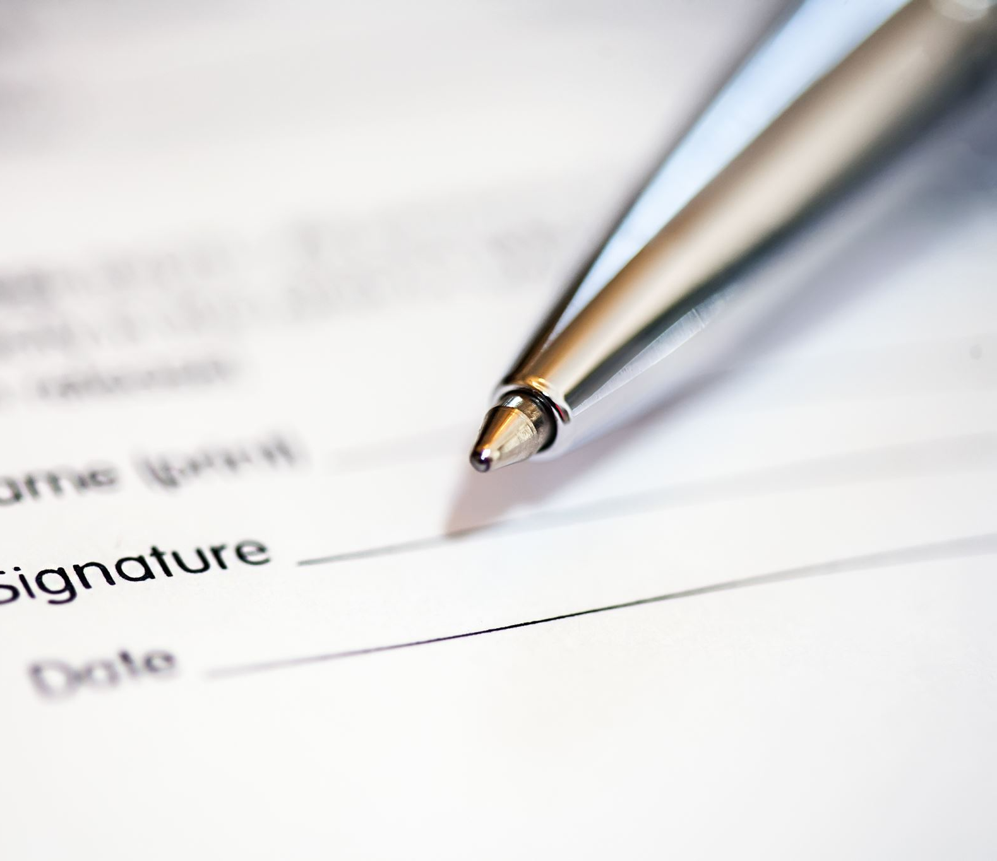
CONTRACTS
Notes:
The first part of our session we will briefly discuss some terms that you might see on your certification exam.

Slide 5
What is a contract?
A contract is an agreement that obligates all parties to do or not do certain act(s).
Notes:
Definitions. Always definitions. Right? Read the slide.

Slide 6
Types of Agreements or Contracts
Allocation of Rights
Collaborative Research Agreement
Consortium Agreement
Data Use Agreement
Interagency Cooperation Contract
Material Transfer Agreement
Memorandum of Understanding
Non-Disclosure Agreement or Confidentiality Agreements (CDA)
Service Agreement
Sponsored Research Agreement or Clinical Trial Agreement (CTA)
Subaward Agreement
Teaming Agreement
Notes:
There are all kinds of agreements and / or contracts. Read the list.

Slide 7
Confidentiality Disclosure Agreement (CDA)
A CDA enables involved parties to share confidential information.
Usually, the first thing that happens in Industry Initiated Clinical Research.
Notes:
When a sponsor approaches a site to determine interest and feasibility, the first kind of document that will be initiated and signed is a Confidentiality Disclosure Agreement. Why? This allows the sponsor to share with the site information, such as, the protocol which is proprietary in nature (trade secrets).

Slide 8
Notes:
Here is an example of a CDA from Harvard. In the background information, it discusses the sharing and disclosure if information.

Slide 9
Clinical Trial Agreement (CTA)
A CTA is an agreement:
negotiated between an organization and an outside entity such as a manufacturer of an investigational product
mutual benefit to cooperate in the conduct of a clinical research protocol
responsibilities and obligations of each of the parties in the conduct of the study
addresses intellectual property and proprietary information
Notes:
The second contract of agreement that is most common in clinical trials is the clinical trails agreement.
Read the slide.

Slide 10
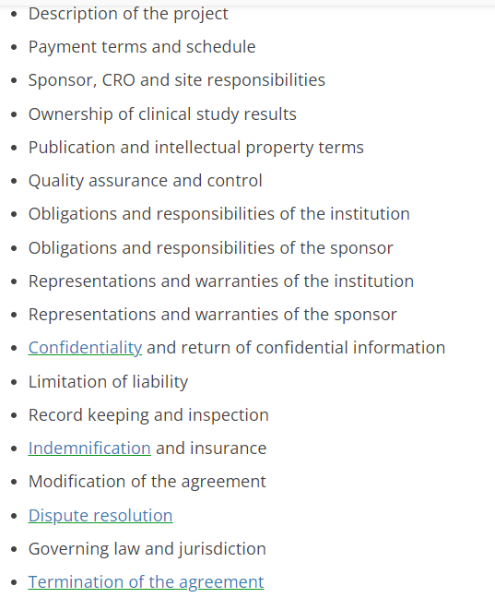
Parts of a Clinical Trial Agreement https://www.agreements.org/
Notes:
Here are the major parts or components of the Clinical Trials Agreement.
Read the lists
So you as study staff should have access to the Clinical trails agreement because you need to know how things will work in your study.
So, in summary, the Confidentiality Disclosure Agreement comes first and after a feasibility study is done and the two parties (the sponsor and the site) agree to work together on a clinical trail the Clinical Trial Agreement is executed. In that order. And the order may be a test question on your exam.

Slide 11
Study Closure
Notes:
Next we are going to move study closure. The end---you have done your job. And now it is time to wrap up the study functions.

Slide 12
Study Closure
Study close-out visit
Essential docs-verification
Resolution of queries
IP accountability
QA/QC
IRB closure submission- outcome letter to sponsor
Final report to clinicaltrials.gov if sponsor-investigator
Notes:
So here are the events that happen during study closure.
Read the slide.

Slide 13
Study Closeout Visit by the Clinical Research Associate / Monitor
Data Query / Resolution Closure
Essential Documents Verification
Investigational Product Accountability and Disposition
Investigator’s Study File and Administrative Items
Ensure that the investigator is aware of their responsibilities after closure
Notes:
When the Clinical Research Associate or Monitor comes for a study close-out visit, the following will occur. Any questions regarding data will be answered and closed. There will be an essential documents verification. Remember Derita did an entire session on Essential documents. There will be an investigational product inventory and then the monitor will determine how the remaining product will be handled or disposed. Your regulatory binder will be view and any files that you have. The monitor will go over what needs to be done after that monitor leaves.

Slide 14
Data Query / Resolution Closure
If all of the data has not been entered / verified, this must be done at the close-out visit by the CRA (Clinical Research Associate), also called the monitor.
The CRC (Clinical Research Coordinator) should do this prior to the closeout visit but sometimes there is not time if the study was stopped abruptly.
Notes:
Let’s take a dive into the data query and resolution closure. The Clinical research coordinator should have already completed any data query or resolution but sometimes there is not time. If such if the case, the monitor will verify and close-out all of the questions at this visit.

Slide 15
Investigation Product Accountability and Disposition
CRA will conduct an inventory of investigational product and supplies.
The leftover product and supplies will be shipped back to the sponsor or disposed according to the protocol.
A copy of the ending inventory should be given to the CRA and, also, kept on file with the investigator
IP reconciliation and supplies should be conducted throughout the study and not left to the closeout visit.
Notes:
Read the slide.

Slide 16
Investigator’s Study File and Administrative Items
The CRA will perform one last reconciliation of site documents to the sponsor’s documents.
All study documents must be present such as IRB approvals and correspondence, protocol amendments and all consent forms.
After the file is complete, it can be placed in storage.
Notes:
So what will the monitor do regarding the investigators’ study file and administrative items.
Read the slide.

Slide 17
Investigator’s responsibilities after closure
Retaining records for the time specified in the Contract Trial Agreement.
Agreement that the sponsor will be notified of any FDA inspections
The investigator must notify the IRB of study closure, send a closure report and send a copy to the sponsor.
Enrollment summary, including the number of subjects who were enrolled, number of completions and those who did not complete the study including the reasons for discontinuation or termination.
Serious adverse events and any other relevant problems or safety information.
List of deviations, corrective actions and outcomes
The IRB notification should occur after study site termination.
Notes:
Let’s go over the responsibilities of the site after the monitor’s closure visit.
Read the slide.

Slide 18
Final Reports
21 CFR 312.62 (c) Final report. An investigator shall provide the sponsor with an adequate report shortly after completion of the investigator’s participation in the investigation.
21 CFR 812.150 Final report. An investigator shall, within 3 months after termination or completion of the investigation or the investigator's part of the investigation, submit a final report to the sponsor and the reviewing IRB.
Notes:
Final reports. Let’s look at what the regulations say.
A review. Remember that 21 FDA 312 are the investigative drug regulations and 21 CFR 812 are the device regulations.
Read the slide.

Slide 19
Test your knowledge

Slide 20
The most common reason for a study to be closed at a site is:
The study is complete
The drug was found to be ineffective
There were safety problems with the drug
Lack of enrollment
Falsification of data.

Slide 21
The most common reason for a study to be closed at a site is:
The study is complete
The drug was found to be ineffective
There were safety problems with the drug
Lack of enrollment
Falsification of data.

Slide 22
By regulation, investigators are required to make a final study report to:
A. The FDA and the sponsor.
B. The sponsor and the IRB
C. The institution
D. The sponsor, the IRB, and the FDA
E. The sponsor

Slide 23
By regulation, investigators are required to make a final study report to:
A. The FDA and the sponsor.
B. The sponsor and the IRB
C. The institution
D. The sponsor, the IRB, and the FDA
E. The sponsor

Slide 24
We have a box of old study documents that have been in our storage facility for years. What should we do with it.?
A. If it has been three years, you may dispose of them because that is the length of time required to keep IRB records
B. If it has been two years post marketing of the approval of the drug, you may dispose of them
C. Ask the sponsor
D. None of the above

Slide 25
We have a box of old study documents that have been in our storage facility for years. What should we do with it.?
A. If it has been three years, you may dispose of them because that is the length of time required to keep IRB records
B. If it has been two years post marketing of the approval of the drug, you may dispose of them
C. Ask the sponsor
D. None of the above
Per the regulations, A and B are the correct answers. In reality, you should always ask the sponsor before you dispose of any study records.

Slide 26
Differences between OHRP, FDA and ICH GCP
Notes:
We will review the handout that is in your study guide to look at the main differences between OHRP, FDA and ICH GCP

Slide 27
Test your knowledge

Slide 28
Prior to releasing detailed information regarding a specific study, A sponsor required the institution / investigator to sign:
A. A confidentiality agreement
B. The protocol signature page
C. An indemnification agreement
D. The Statement of the Investigator

Slide 29
Prior to releasing detailed information regarding a specific study, A sponsor required the institution / investigator to sign:
A. A confidentiality agreement
B. The protocol signature page
C. An indemnification agreement
D. The Statement of the Investigator

Slide 30
Emergency use of a test article and emergency research are circumstances covered in which of the following:
FDA
OHRP
Both FDA and OHRP
ICH
FDA, OHRP, and ICH
FDA and ICH

Slide 31
Emergency use of a test article and emergency research are circumstances covered in which of the following:
FDA
OHRP
Both FDA and OHRP
ICH
FDA, OHRP, and ICH
FDA and ICH

Slide 32
Which of the following are necessary to waive consent?
Subject is unable to give consent
No time or unable to contact the Legally Authorized Representative
Life threatening condition
No other treatment available.
None of the above
a, b, c, and d

Slide 33
Which of the following are necessary to waive consent?
Subject is unable to give consent
No time or unable to contact the Legally Authorized Representative
Life threatening condition
No other treatment available.
None of the above
a, b, c, and d

Slide 34
Questions?
Notes:
This concludes our 2022 Certification Examination Review Class. Derita and I are very glad you joined us. We hope that this class has helped you prepare for your exam.
Look for an evaluation survey in your email in a couple of weeks. Please complete it. There will be another survey after the SOCRA exam at St. Jude. We want to know whether or not the class helped you pass the test. Thank you so much and please contact Derita and me if you have any questions.

