Slide 1
Managing your Research Flow with EndNote
Hilary Jasmin, MSIS
Assistant Professor
Research and Learning Services Librarian

Slide 2
Learning Objectives
Define EndNote and understand how it fits into your research
Understand how to add citations from databases, create references, and organize your libraries
Utilize Cite While You Write in a Word or Pages document
Differentiate options between desktop, and web versions
Find where to download EndNote for desktop from UT’s software options

Slide 3
Scenario
You are on a research team and have been tasked with building a literature review about the affects of COVID-19 on breastfeeding. You need to go into multiple databases to find a variety of articles. You also need to find PDFs of the full-text. Once you’ve found all your articles, you need to write your literature review and use AMA citation style for your in-text citations as well as your bibliography.
Where do you begin?

Slide 4
EndNote: A citation management software that lets you collect, organize, and share citations for research or assignments.

Slide 5
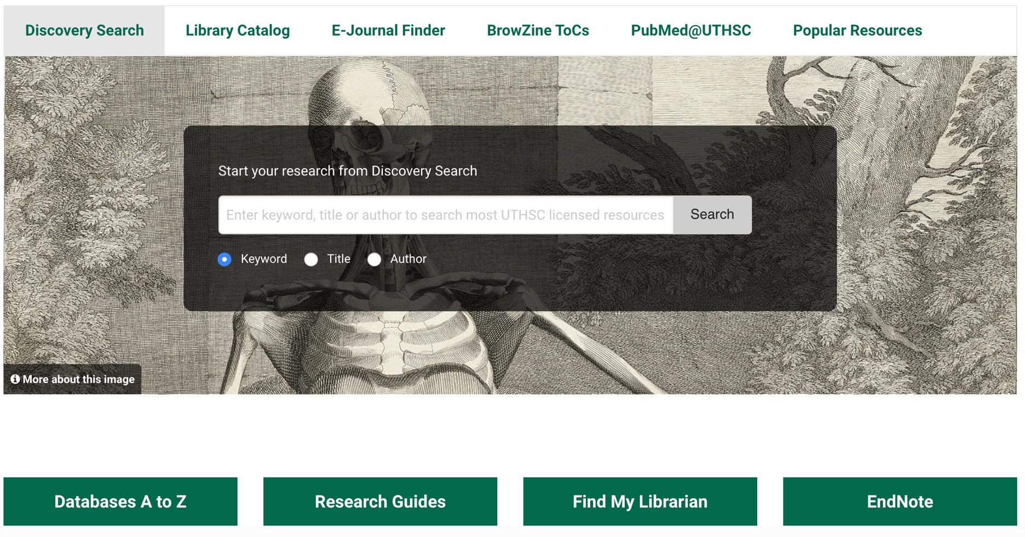
The Research Guide

Slide 6
Can I get references into EndNote from ____?

Slide 7
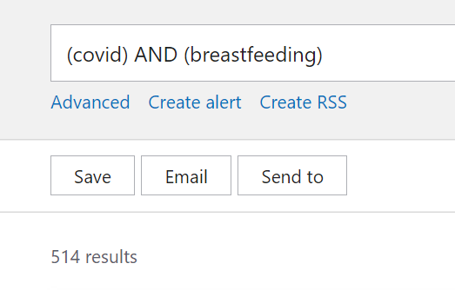
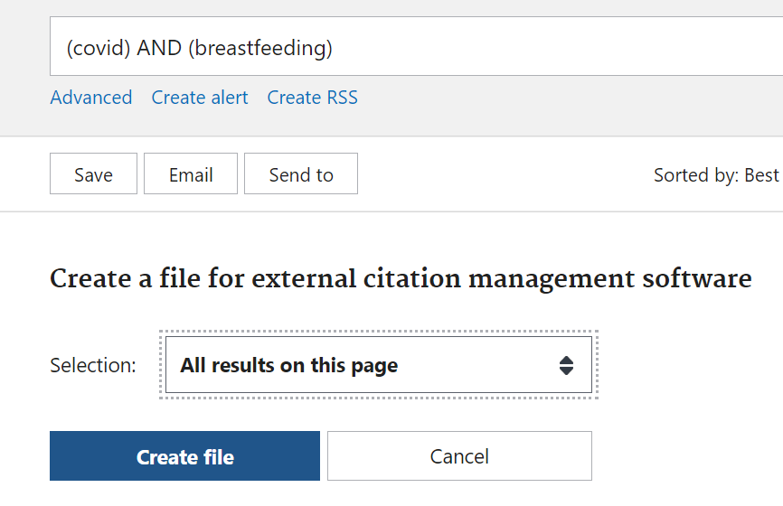
PubMed
Send To > Selection > Create file

Slide 8
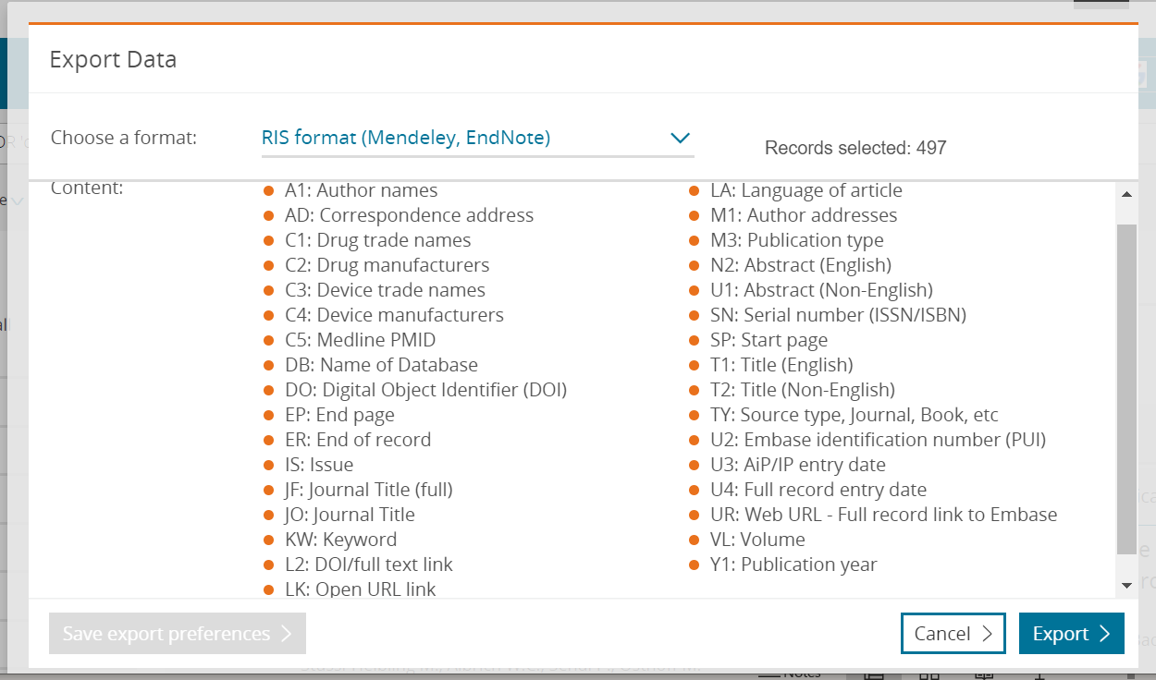
Embase
Select Result Amount > Export

Slide 9
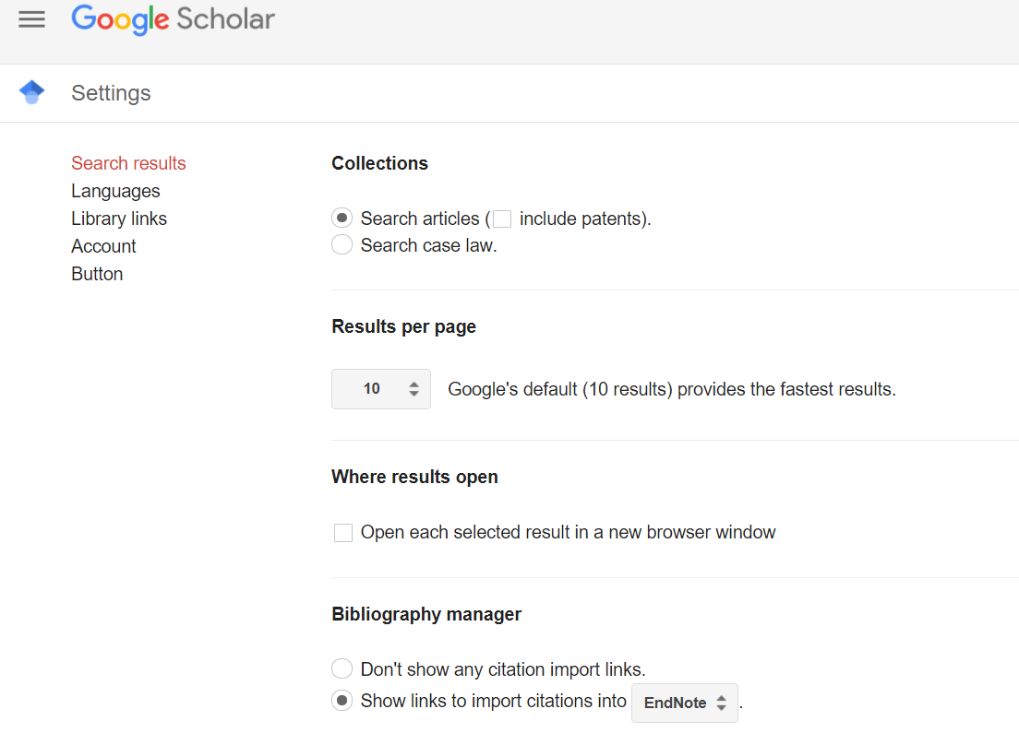
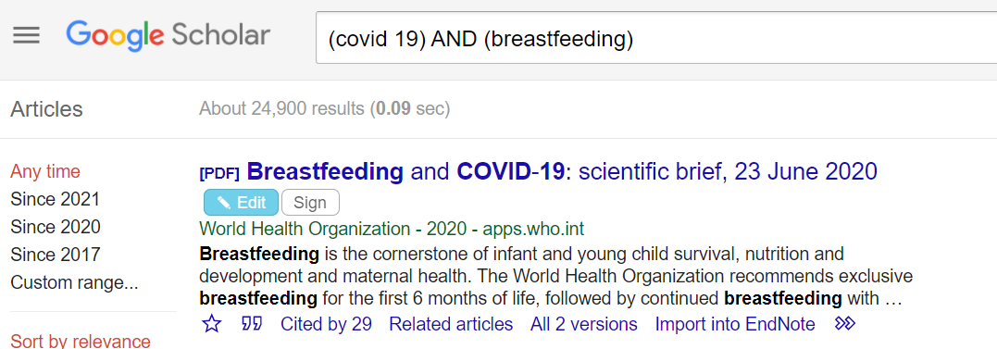
Google Scholar
Update Settings for EndNote >
Import into EndNote

Slide 10
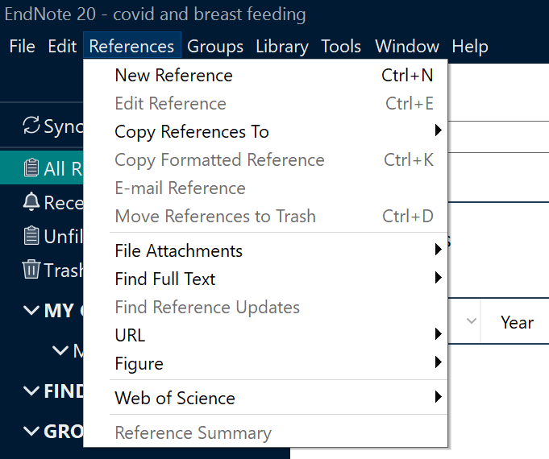
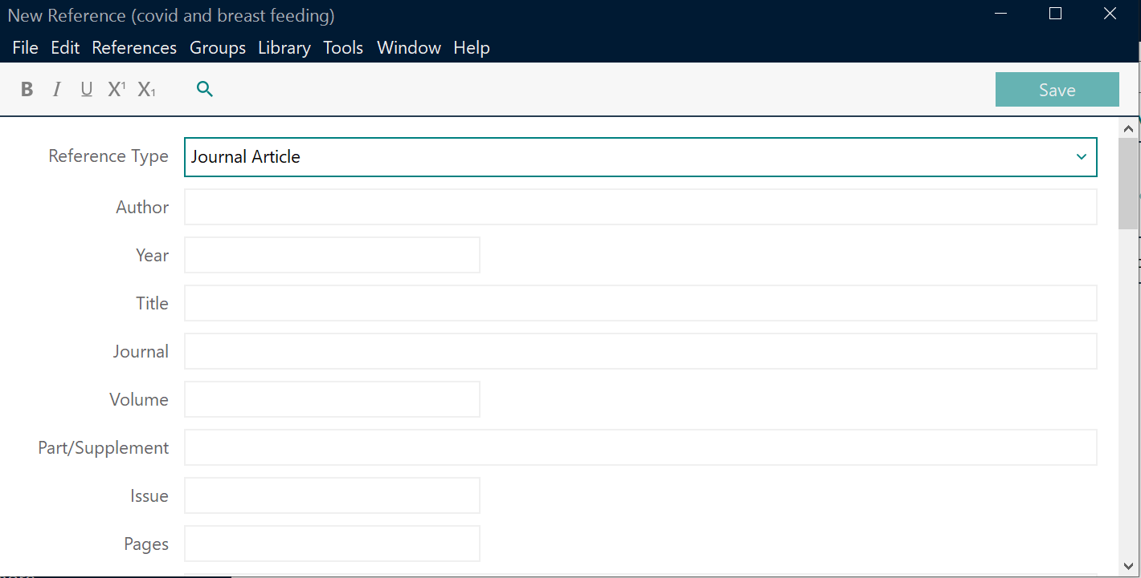
Manually Create a Reference

Slide 11
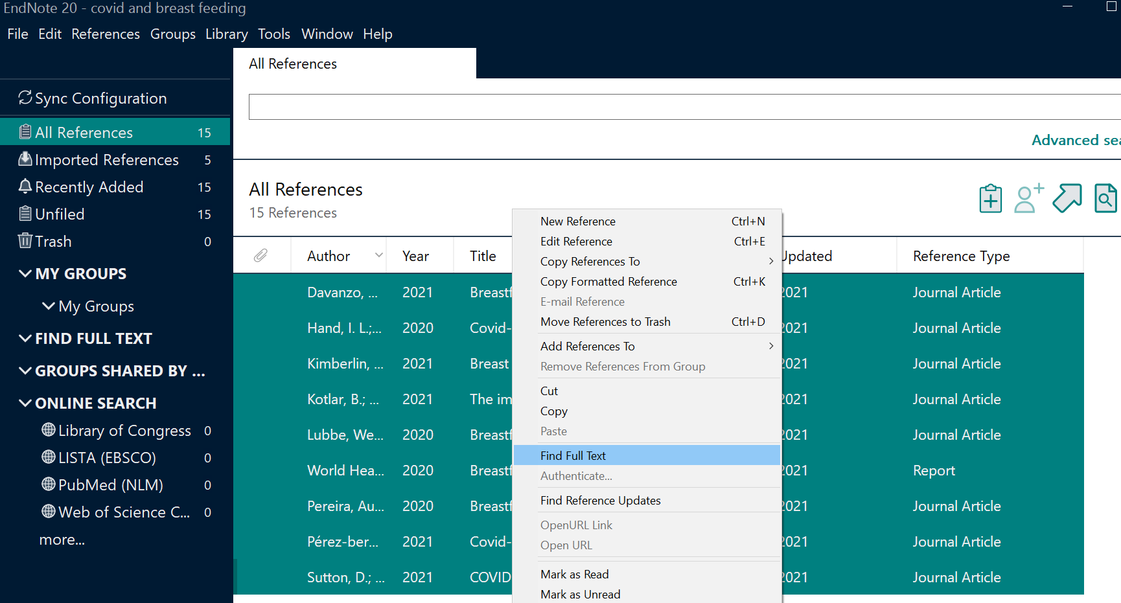
Finding Full-Text

Slide 12
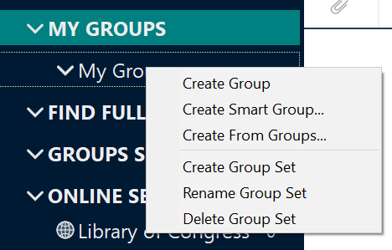
Organization
Group: Manually add references by drag + drop
Smart Group: Define search terms so that references will be automatically added to group
Group Set: Serves as a header. Groups and Smart Groups can exist within a Group Set.

Slide 13
Cite While You Write
CWYW enables you to customize your manuscript to the desired style or format required by your publisher, journal, or instructor. You can create in-text citations as you write, and your bibliography will be built as you go!

Slide 14
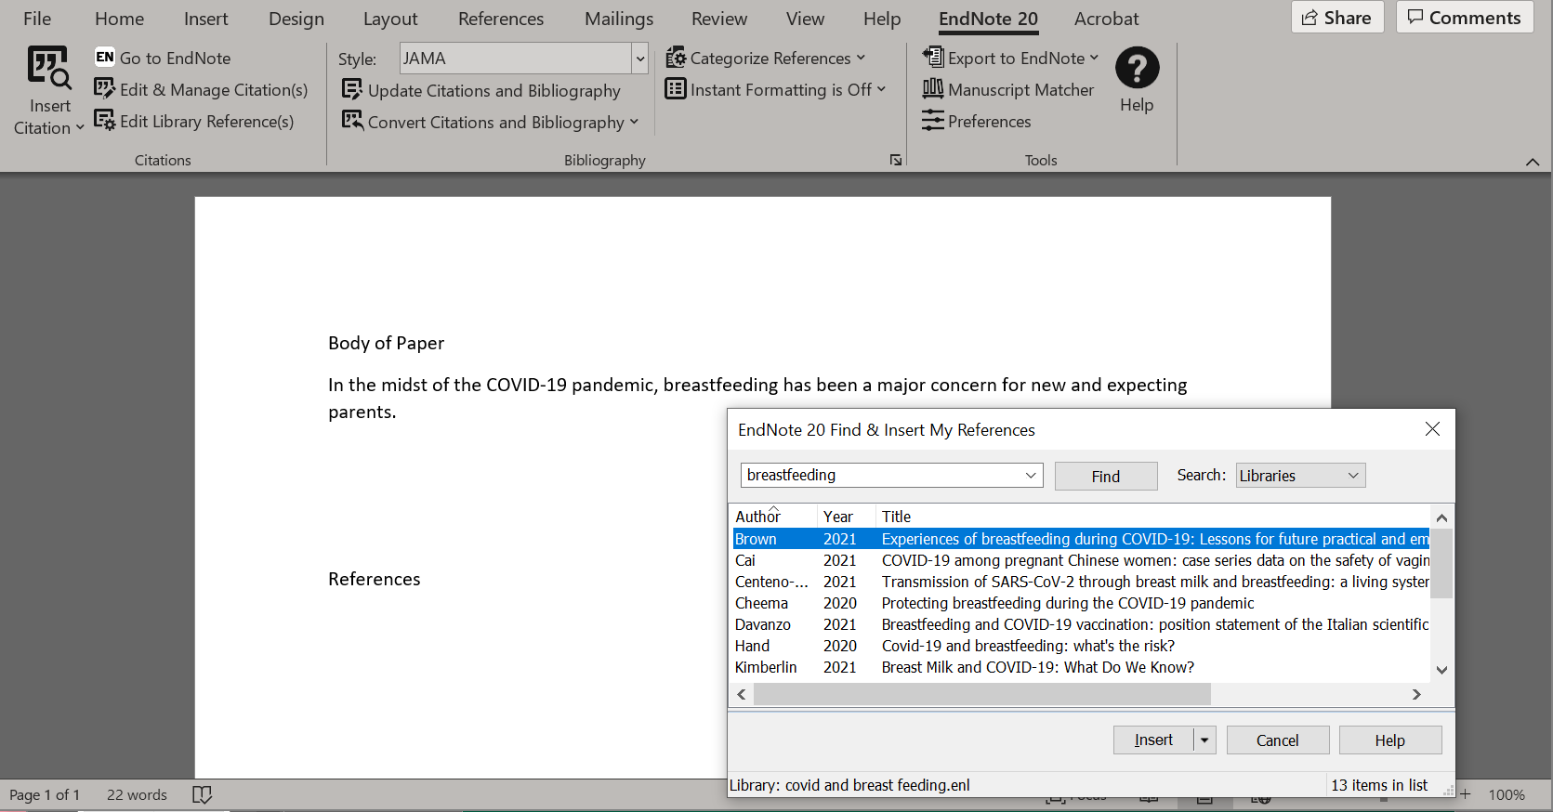
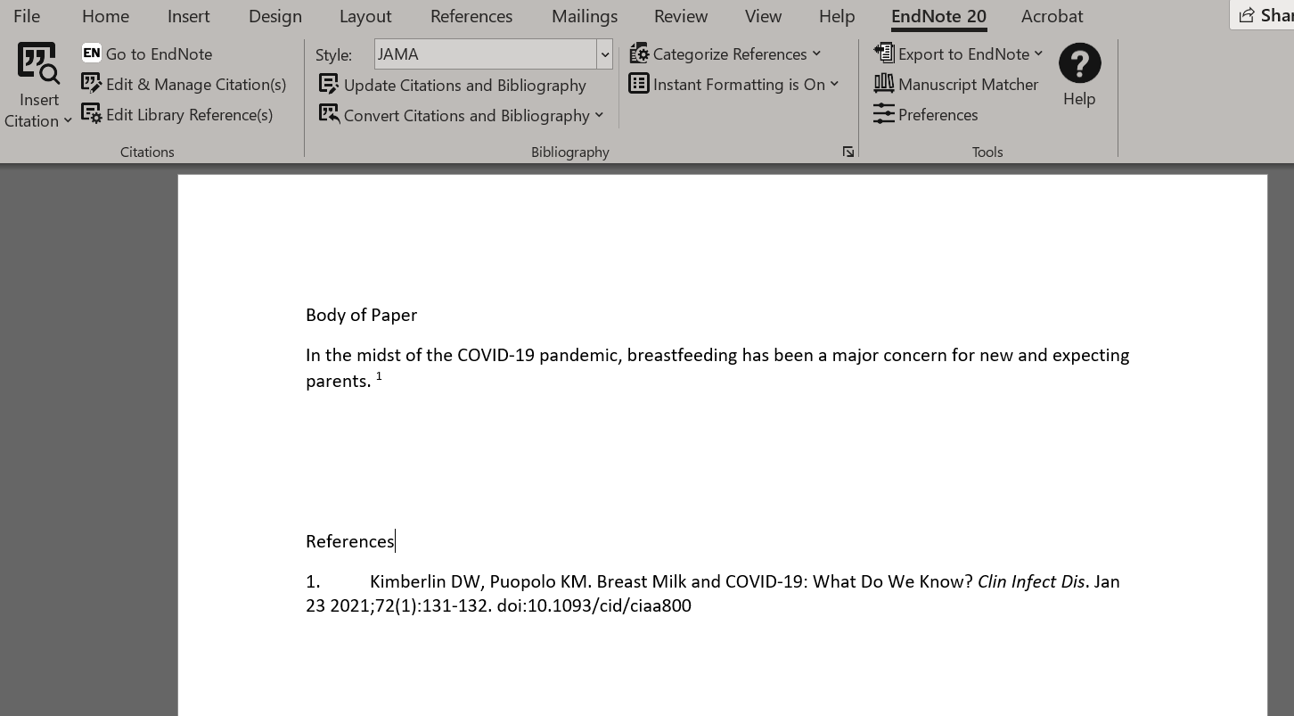
Cite While You Write

Slide 15
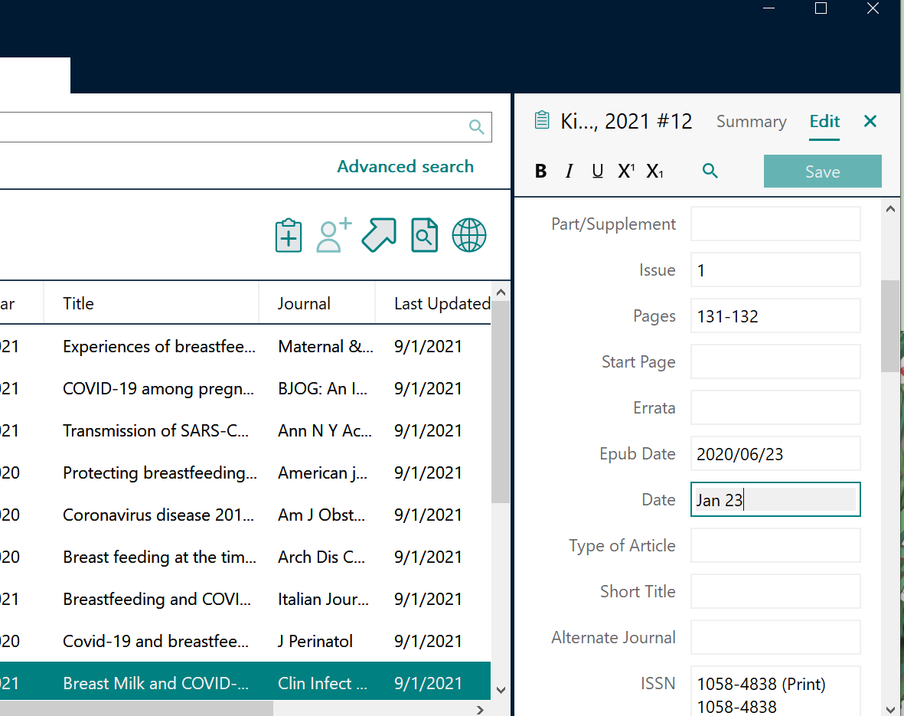
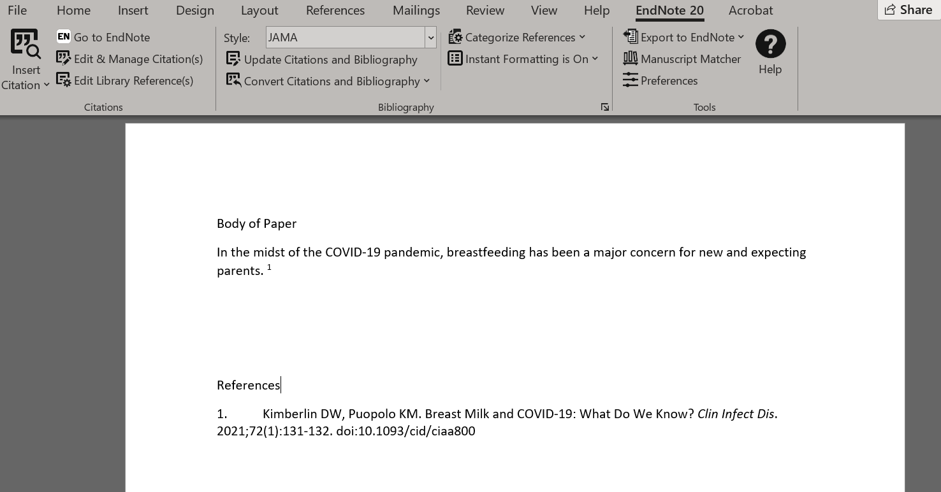
Cite While You Write… but don’t forget your citation style!
CWYW is a great time-saver,
but no software is perfect.
Make sure you still review
for any style errors.

Slide 16
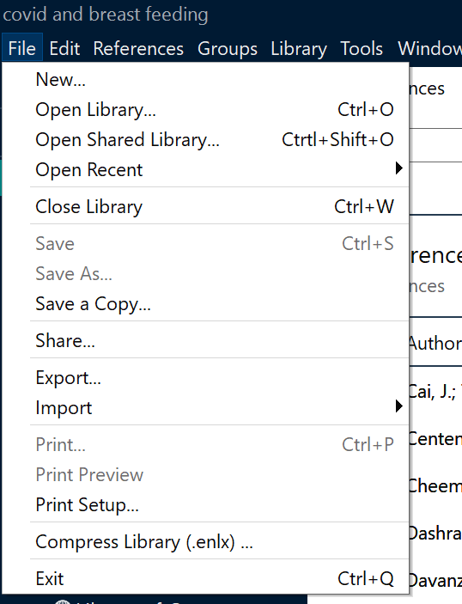
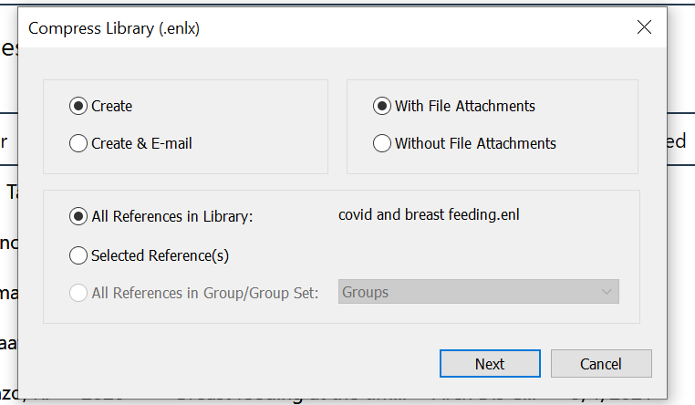
Sharing your Library
…with EndNote users

Slide 17
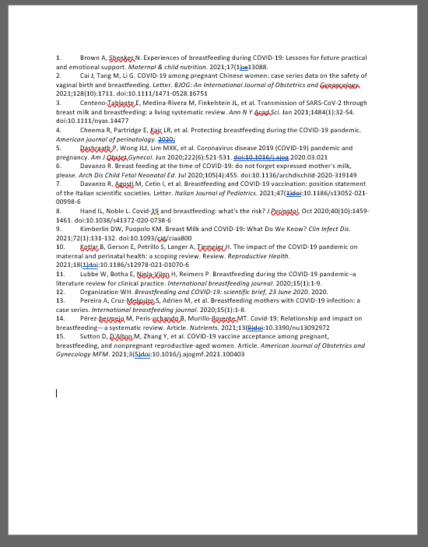
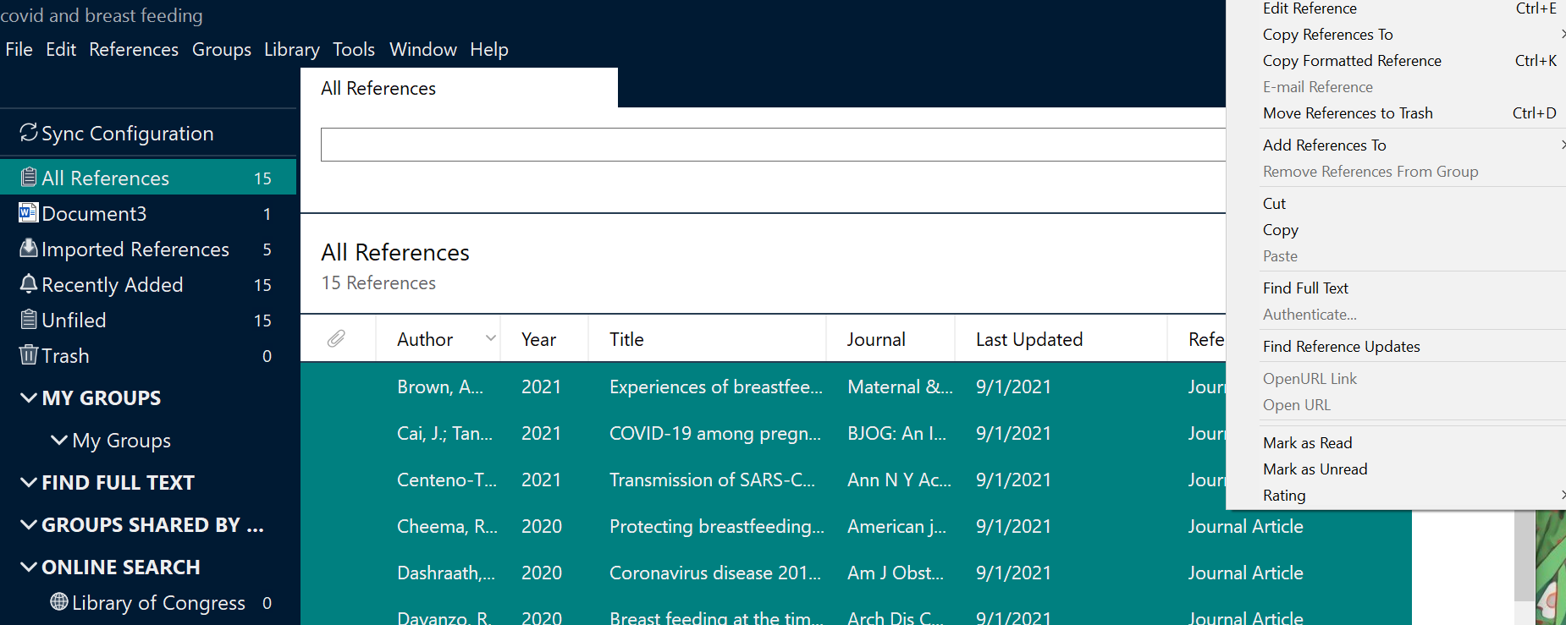
Sharing your Library
…with non-EndNote users

Slide 18
What if I don’t have access to EndNote through UTHSC?
EndNote for Desktop (via UTHSC) | My EndNote Web (free)
Cite While You Write automatically added to Microsoft Word | Cite While You Write plug-in must be installed
7,000+ bibliography styles, plus ability to create your own | Top 21 most popular styles
Fulltext | Fulltext?
Unlimited file attachment storage | Up to 2GB file storage
Unlimited reference storage | Up to 50,000 references
https://www.endnote.com/product-details/compare-current-versions
www.myendnoteweb.com

Slide 19
Ready to install?
https://oit.utk.edu/software-hardware

Slide 20
Next: Demonstration of EndNote desktop, then EndNote Web

Slide 21
Library Research Guide for Clinical Researchers https://libguides.uthsc.edu/clinicalresearchers

Slide 22
Questions?
Research & Learning Services
UTHSC Health Sciences Library
library@uthsc.edu

Slide 23
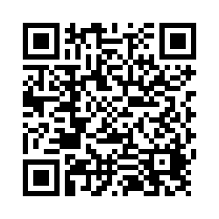
Please scan the QR code to complete the session evaluation. You may take a photo of your certificate, email it to yourself and print.

