Slide 1
PI Research Training sponsored by

Slide 2
Disclosures
Successful Completion of this Nursing Professional Development Activity: In order to receive full contact credit(s) for this NPD activity, you must:
• Be in attendance for at least 80% of the program, and
• Complete and submit the Evaluation and Verification of Attendance at the conclusion of the program.
Requirements for successful completion may also include participation in individual or group activities, such as discussion, exercises, practice questions, pre- / post-testing, etc.
Conflicts of Interest: A Conflict of Interest occurs when an individual has an opportunity to affect educational content about health-care products or services of a commercial interest with which she/he has a financial relationship. The planners and presenters of this NPD activity have disclosed no relevant financial relationships with any commercial interests pertaining to this activity.
Commercial Support: No Noncommercial Sponsor Support: No
Off-label Product Use: This NPD activity does not include any unannounced information about off-label use of a product for a purpose other than that for which it was approved by the Food and Drug Administration (FDA).
Notes:
We have no conflict of interest to declare

Slide 3
Who is CBMI?
Center for Biomedical Informatics
Supported by University of Tennessee Health Science Center (UTHSC)
Mission
Research Electronic Data Capture (REDCap)
Develop and support a state-wide EDW (TriNetX)
Perform research to advance medical knowledge utilizing advanced informatics technique
Expert Data scientist within the center
Director: Robert Davis, MD, MPH

Slide 4
What is REDCap?
REDCap is a secure web-based application that supports data capture and management for research studies
Originally designed at Vanderbilt University, it is now used at more than 2000 institutions worldwide
REDCap is user friendly and menu-driven processes for rapidly developing databases
Does not required in-depth IT knowledge or constant IT Tech Support to use
Users will be able to quickly and intuitively build and manage research data forms and surveys

Slide 5
Common Misconceptions about REDCap
REDCap is designed for Collecting Information
It is:
Not a Data Storage system
Not a Statistical/Analytical tool
Not a Data Anonymization tool

Slide 6
Features
Create forms for data entry and surveys
Enter data with workflow for managing the project
Surveys delivered to participants electronically
Reuse of forms for multiple events/arms
Data export to common statistical packages with de-identification tools
Data import from Excel and XMl formats
API capability
Real time quality rule checks and post collection data query resolution
Full audit trail

Slide 7
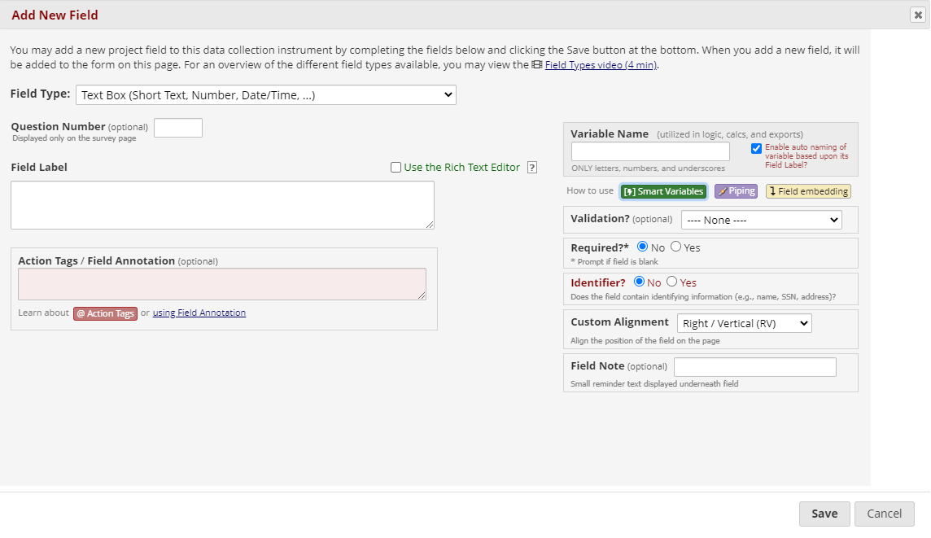
Form Development
Notes:
The 'Piping' feature in REDCap allows you to inject previously collected data into text on a data collection form or survey, thus providing greater precision and control over question wording.
In REDCap Field Notation, variable names always point to data fields in the project. However, another type of entity exists called 'Smart Variables' that allow you to reference information other than data fields. Smart Variables are context-aware and thus adapt to many different situations in which they can know who the current user is, what event is currently being viewed, whether or not an instrument is being viewed as a survey or data entry form, etc. In this way, Smart Variables are dynamic (and thus 'smart') because they adapt to the current context in which they are used.
The 'Field Embedding' feature in REDCap is the ultimate way to customize your surveys and data collection instruments to make them look exactly how you want.

Slide 8
Field Types and Validation
Define Field Type
Determine validation

Slide 9
Data Entry

Slide 10
Reporting & Exporting Data
Exports to most common statistical packages
De-identification Options
Automatic removal of pre-specified identifiers
Date Shifting
Automatic removal of text and note fields
Develop quick reports for quality control
Audit logs

Slide 11
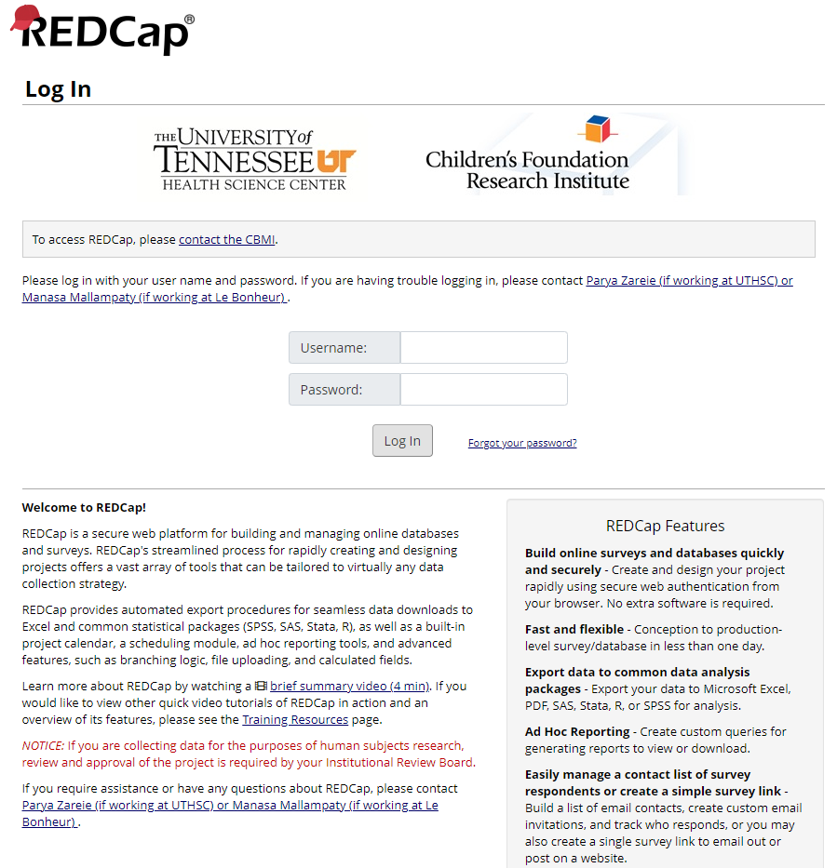
REDCap Demo
Hands on experience with redcap.uthsc.edu

Slide 12
Security & Integrity
Audit logs
Role-based user rights
Annual Risk Analyses
Developed Standard Operating Procedures for:
Training
Access
Risk Management
Test Plans
Regularly scheduled network security scans
Regularly receives updates
Data stored in the Data Center and backed up nightly

Slide 13
Training
REDCap Introductory Session
Offered Monthly by Center for Biomedical Informatics at University of Tennessee Health Science Center (Both in person and via Zoom)
Required for at least one project member
Vanderbilt tutorials
Available free on web (www.project-redcap.org)
Excellent step-by-step instructions through all modules
Peer Training

Slide 14
More information
Visit our website at https://uthsc.edu/cbmi/services/redcap.php
Vanderbilt University’s website for REDCap www.project-redcap.org
For further information, contact: redcap@uthsc.edu
Questions…

