Slide 1
Informed Consent Process (ICP):
Who, What, When, Where, Why, and How?: Doing it Right!
Presented by: Derita Bran, BSN, RN, CCRC
Program Director
Tennessee-Clinical and Translational Science Institute (TN-CTSI)

Slide 2
Disclaimer
This slide presentation is of general information and should not be considered all-inclusive of information regarding informed consent process
The Informed Consent Process (ICP) will be discussed for subjects who are capable of giving consent for themselves and will not include waiver or alteration of the process
The presenter has no financial or other interest relevant to the subject matter
*Co-sponsored by TN-CTSI and the UTHSC Office of Research Development

Slide 3
Objectives
Identify regulations/guidance for the informed consent process (ICP)
Examine processes utilized to conduct the informed consent process
Discuss components and best practices when conducting the informed consent process
Recognize errors and review corrective action and preventions

Slide 4
Regulations/Guidance
45 CFR 46
21CFR 50 and 312
ICH GCP E6 (R2)
FDA Information sheets
Belmont Report
Nuremberg Code
Declaration of Helsinki
IRB SOPs
Protocol
Department/Institution policies

Slide 5
What: What is Involved in the ICP?
More than the signing of the Informed Consent Form (ICF)
It is a ongoing process
Begins with the first contact/conversation regarding the study with the potential subject
Discussion/Exchange of information/Dialogue
Processing of information
Consideration of participation
Need for additional information and/or clarification of information

Slide 6
What: What is the ICP?
Interactive/different for every subject/different for every study
Voluntary agreement
Assessment/Statement of their understanding of the protocol/study procedures
Assessment of subject’s competence, understanding of the protocol procedures, and ability to make informed decision
Signing of the informed consent form (ICF)
Allows for re-education/continuation of informed consent at each subsequent visit and throughout participation and possibly after participation
*The process must occur without the possibility of
coercion or undue influence

Slide 7
What: What is the ICP?
Informed consent does not end with the signing of a document
At each subsequent study visit, the following should occur and be documented:
Assessment that the subject understands what is being asked of him/her for the subsequent visit
The subject has an opportunity to ask questions and they are answered to their satisfaction
The subject truly wants to continue participation in the study

Slide 8
Why: Why is the ICP Necessary?
Ethical requirement
Ensures the subject is fully and accurately informed
Demonstrates comprehension of the information
Authenticates decision is voluntary
Protect the rights, safety and well-being of subjects

Slide 9
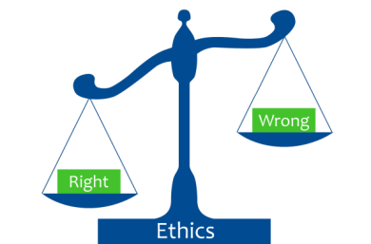
Why: Why is the ICP Necessary?
To Protect the Subject’s Rights
Primary concern of researchers should be the safety of the research subjects
Respect for persons
Justice
Beneficence
Autonomy

Slide 10
Why: Respect for Persons
It is a statement of basic ethical principles and guidelines that should assist in resolving the ethical problems that surround the conduct of research with human subjects
Respect for persons demands that subjects enter into the research voluntarily and with adequate information
The principle of respect for persons thus divides into two separate moral requirements: the requirement to acknowledge autonomy and the requirement to protect those with diminished autonomy
Respect for persons requires that subjects, to the degree that they are capable, be given the opportunity to choose what shall or shall not happen to them. This opportunity is provided when adequate standards for informed consent are satisfied.

Slide 11
Why: Justice
All subjects should be treated fairly
Study should have a general benefit to a subject/group, society, or to the advancement of medical knowledge
An injustice occurs when some benefit to which a person is entitled is denied without good reason or when some burden is imposed unduly

Slide 12
Why: Beneficence
Persons are treated in an ethical manner not only by respecting their decisions and protecting them from harm, but also by making efforts to secure their well-being
Two general rules have been formulated as complementary expressions of beneficent actions in this sense: (1) do not harm and (2) maximize possible benefits and minimize possible harms
Investigators and members of their institutions are obliged to give forethought to the maximization of benefits and the reduction of risk that might occur from the research investigation

Slide 13
Why: Autonomy
Respect for all people
To respect autonomy is to give weight to autonomous persons' considered opinions and choices while refraining from obstructing their actions unless they are clearly detrimental to others
Full disclosure is given and the individual has the right to determine if they want to participate
Requires an individual be able to understand what they are being asked to do
Requires an individual to make a reasoned decision on whether to participate or not, right to make their own decision

Slide 14
Who: Who can obtain the IC?
The person obtaining consent must be qualified by
education, training, and/or experience!
Principal Investigator
Person obtaining IC should be/have:
listed as key study personnel on IRB application as being able to obtain IC
delegated on the Delegation log (DOA/DOR) by PI for this task
current CITI HSP/GCP training, (as applicable)
protocol training and documentation of the training
adequate medical knowledge/understanding understanding of the protocol procedures and IP (as applicable)
good communication skills

Slide 15
When: When Should the ICP be Conducted?
Obtain consent before initiating ANY study-specific procedures, this includes wash-out periods (as applicable)
Every subject contact is an opportunity to reiterate information and ensure the subject continues to be fully informed and is voluntarily participating
If new information is learned that could affect the subject’s willingness to continue participation or changes to the protocol occur for the subject, the subject should be re-consented

Slide 16
Where: Where should the ICP be Conducted?
Setting:
quiet,
comfortable, and
private

Slide 17
How: How to Conduct the ICP?
The consent process can be analyzed as containing three elements and broken up into three sections:
information,
comprehension, and
voluntariness

Slide 18
How: How to Conduct the initial ICP?
Introduce yourself (establish a relationship with the subject)
Know the protocol
Consistent with IRB approved process
Explain the consent procedures and process to the subject
Discuss the ICF with potential subject
Allow adequate time to read the ICF and consider participation and all options
Allow appropriate amount of time for the subject to ask questions and have them answered in an satisfactory manner
Ensure subject is fully informed

Slide 19
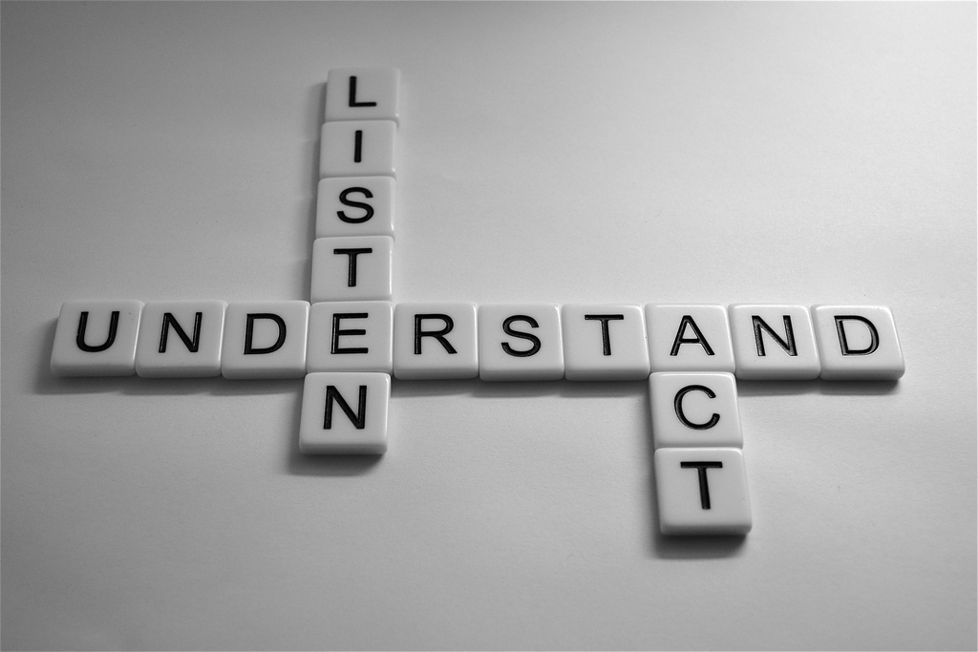
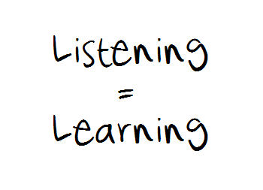
How: How to Conduct the ICP?
Keep the subject in the center of the process
Be an active listener
Ask open-ended questions to assess understanding and comprehension
Be aware of non-verbal messages
Verify his understanding of the research study throughout the process
Be available anytime for any question and answer to subject’s satisfaction
Do not rush the process or the subject/ample time to consider participation

Slide 20
How: How to Conduct the ICP?
Using language understandable to the subject
Discussion and subject demonstrates understanding
Explanation and discussion performed without coercion or undue influence to participate
Correct version of the ICF was utilized (process for old version)
Usage of ICF aids: visual, demonstrations, etc. (must be IRB approved)

Slide 21
How: How to Conduct the ICP?
Assessing comprehension:
Teach-back ( “Tell me in your own words”)
Ask open-ended questions
How would you describe the purpose of the study to your family?
What will happen to you in this study?
What are the benefits of you participating in the study?
What are the potential risks involved if you participate?
What are the alternatives treatments available to you if you do not participate??

Slide 22
What: What Will be Discussed During the ICP?
The essential elements of the ICF
Research Voluntary participation Length of participation | Purpose/Procedures Which procedures are research and which are considered standard of care Risk/benefits/discomforts | Alternatives to participation Confidentiality Compensation for injury Contact Information

Slide 23
What: What Will be Discussed During the ICP?
The additional elements of the ICF:
Risks if the subject is or may become pregnant | Circumstances under which the subject’s participation may be terminated by the PI | Additional costs to the subject
New findings that may affect willingness to participate | Approximate number of subjects | Consequences of a subject’s decision to withdraw

Slide 24
What: What Responsibilities Do We Have as Researchers?
Protect the subject’s rights and safety
Assure each person is adequately informed
Ensure each subject volunteers without coercion or undue influence to participate in the study
Reduce risk to a minimum for the subject/do no harm
Perform delegated tasks according to the protocol and which you are qualified to conduct

Slide 25
What: What Are Some Barriers to Conducting the ICP?
For the subject:
Cognition/capacity
Level of education
Social/cultural values
Language
Age
Environment
Anxiety/fear
Readability of the ICF
Length of the ICF

Slide 26
What: What Is Needed After Obtaining Consent?
Original to be maintained with research documents unless approval by IRB to maintain in different manner
Give a copy to subject, give a signed copy if following ICH GCP E6(R2)
Completion of the ICP documentation
Document/place a copy of the signed ICF in the subject’s medical record (if required)
Document continued desire to participate at each subsequent study visit
Re-Consent if needed
Remember--- IT IS an ONGOING PROCESS??

Slide 27
What: What to Document regarding the ICP?
Utilize a template for documentation of the process
Sufficient opportunity to consider participation
ample time and opportunity to inquire details of the trial
ICP conducted without coercion or undue influence
Subject states understanding of procedures, risks, and benefits
ICF signed and dated before any study procedures were performed

Slide 28
What: What Are Some Audit Findings Associated with the ICP?
Use of incorrect ICF/expired ICF
Research team completing dates/times for subject
Missing signatures/Omission of initials on each page (if this is a requirement)
Subjects not re-consented with revised consent
Incomplete/Incorrect dates/times
Check boxes within the consent incomplete

Slide 29
What: What Are Some Audit Findings Associated with the ICP?
Correction does not follow the SLIDE rule (single line, initialed by person making correction, date, explanation of correction if needed) or the use of white out
Investigator signature outside of 72 hour window (if this is a requirement)
ICP documentation not found
Person obtaining consent not qualified (not on DOA, not on IRB application)

Slide 30
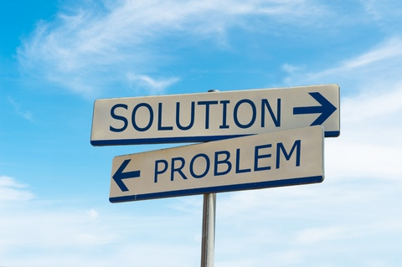
What: What Needs to be Performed to Correct Errors?
Re-training
Memo/Note to files for additional clarification
Report to the IRB per IRB SOPs
Internal audits
CAPA (Corrective and Preventive Action)

Slide 31
What: What Should You Do To Avoid Mistakes?
Double check the ICF before ending the consent process for initials/dates/times/signatures, etc.
Ensure the correct version of the consent is the only version available to the research team
Make corrections to the ICF at the time of the ICP if needed
Know the appropriate way to correct errors
Create procedure if re-consenting is needed
Obtain needed signature of investigator within 72 hours
Utilize a template to document the ICP
Make sure that all study team members that are obtaining consent are qualified
Learn from previous errors made by you and others

Slide 32
What: What To Do If Mistakes/Errors Occur?
Perform a root cause analysis
Document on protocol deviation log
May need to report to IRB depending on the error(s)
Correct as soon as possible
Follow ALCOA-C (Attributable, Legible, Contemporaneous, Original, Accurate and Complete
Follow the SLIDE (single line, initial, date, error) rule

Slide 33
Summary-Doing IT Right!!
Remember:
Follow the applicable regulations, guidance, and/or SOPs for obtaining consent
The ICP is conducted to protect the rights, safety, and well-being of subjects
To ensure the subject is fully informed and has a good understanding of the research procedures
To be proactive if mistakes/errors occur, implement the appropriate CAPA
The process is on-going
Take your time and DO IT RIGHT!!

